Slide 1
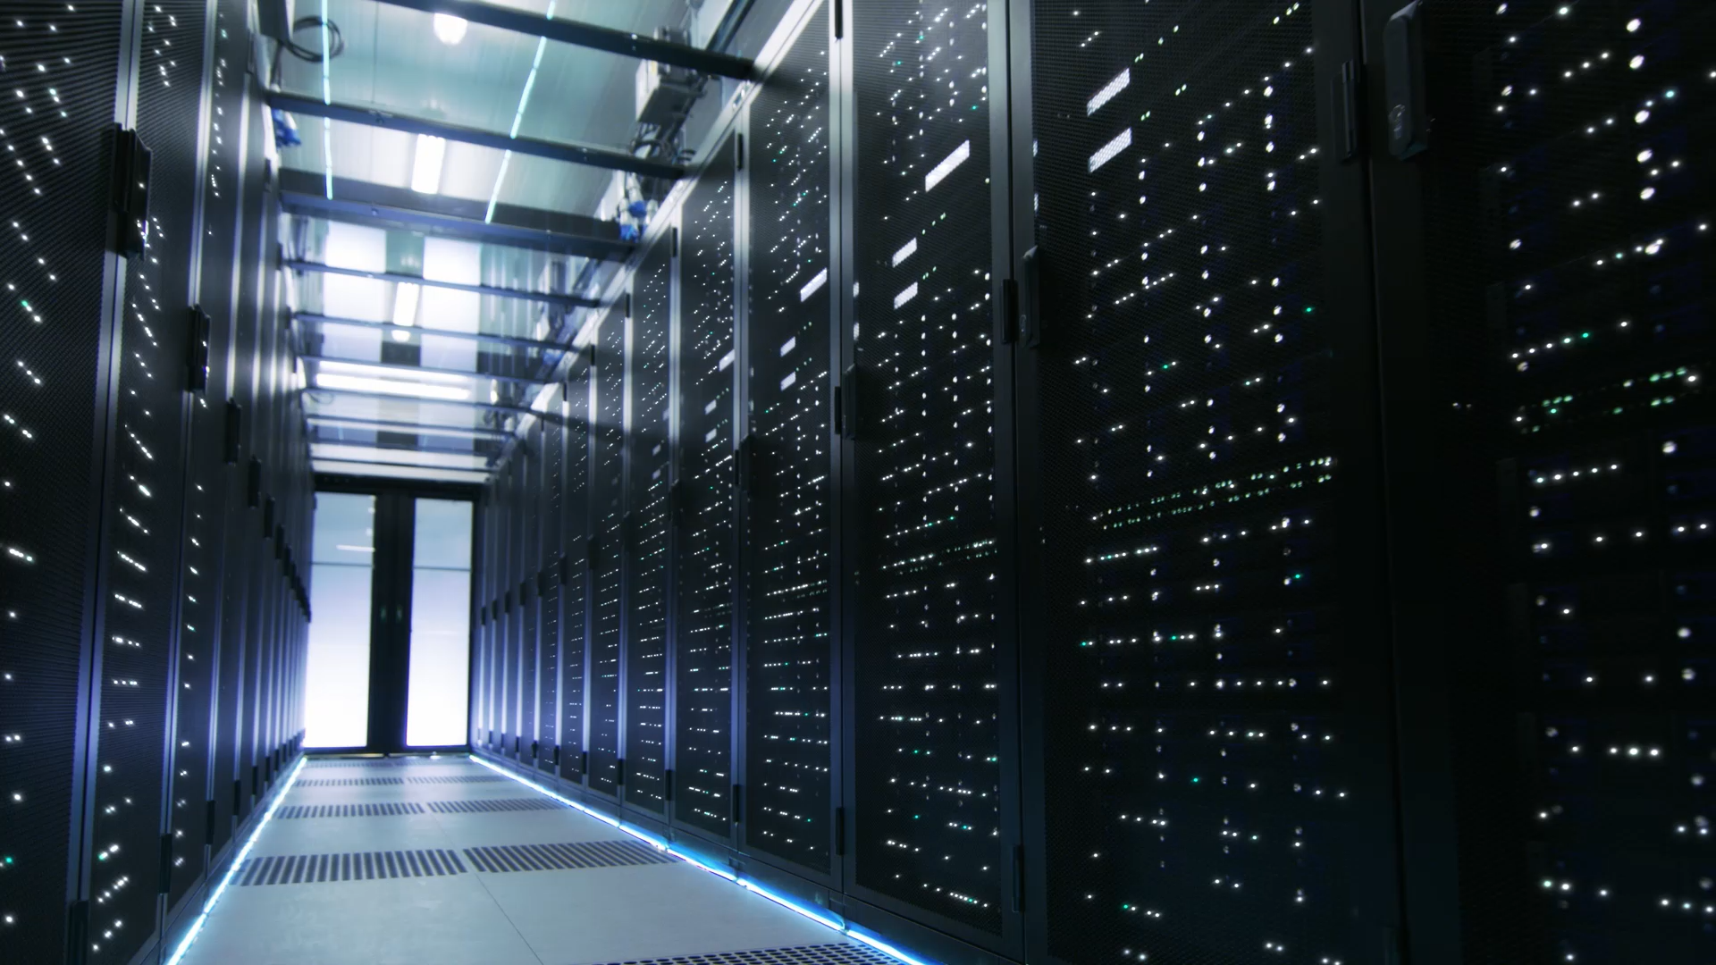
Isolation-Centric Operating Systems for the Enterprise
Jacob Chlebowski
Notes:
-This is a presentation on my MQP project
-I was originally going to do a presentation on MITRE, but it was a few years ago and the project was BASIC (come to me with questions about my experience)

Slide 2
Problem and Need for Solution(s)
Problem
Ransomware introduces over $2 billion in damages to enterprises
Need
IT Administrators need a scalable way to secure organization’s assets to reduce the cost in damages
Observation of anomalous activity (My Team)
Notes:
-MAIN PROBLEM and NEED
-Other teams did focus on isolating applications and configuring network policies for security, but…
-My team focused on how IT administrators can better observe anomalous activity, with the utilization of VMs (REGULAR USERS WON’T UNDERSTAND WHAT A VM IS)
-RQ1: With the sensors available in the sandbox, what amount of information is need to distinguish different scenarios (AKA ransomware attacks)?
-RQ2: Can our solution distinguish aligned and non-aligned UI activity?

Slide 3

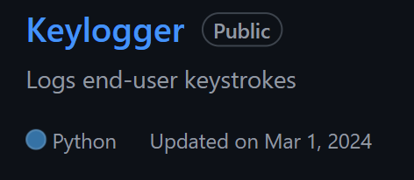
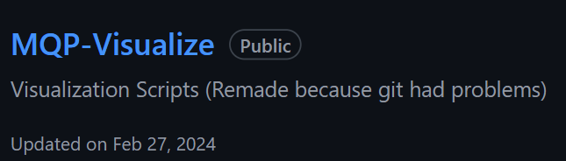
Our Novel Solution
Ransomware
The Result…
Notes:
3 Components. WE GLUED pre-existing tools with our own implementations for a solution that can graph time-series data based on anomalous file-system modifications

Slide 4
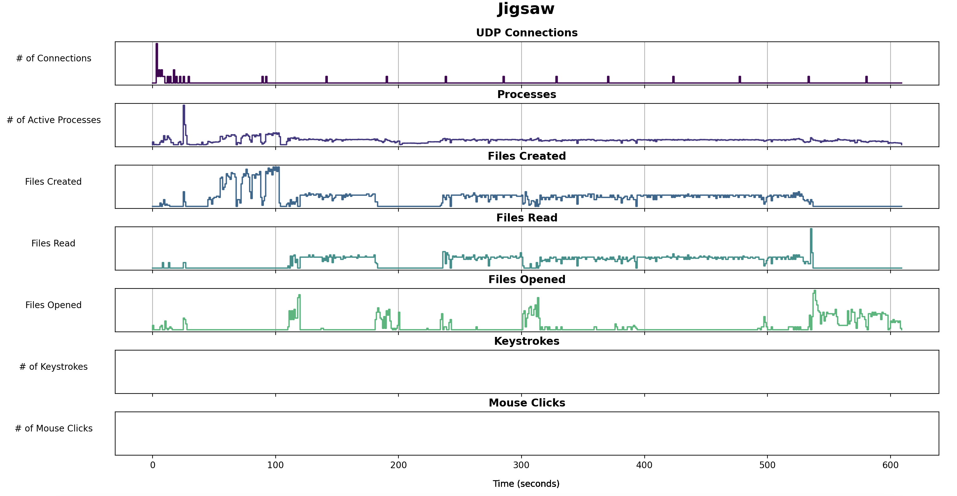
Results
Notes:
-And our results were a time-series graph that represents background processes as well as user interactions
-THIS IS A NOVELTY BECAUSE no research in the past has compared USER ACTIVITY with MALICIOU ACTIVITY (TO FIND CORRELATIONS)

Slide 5
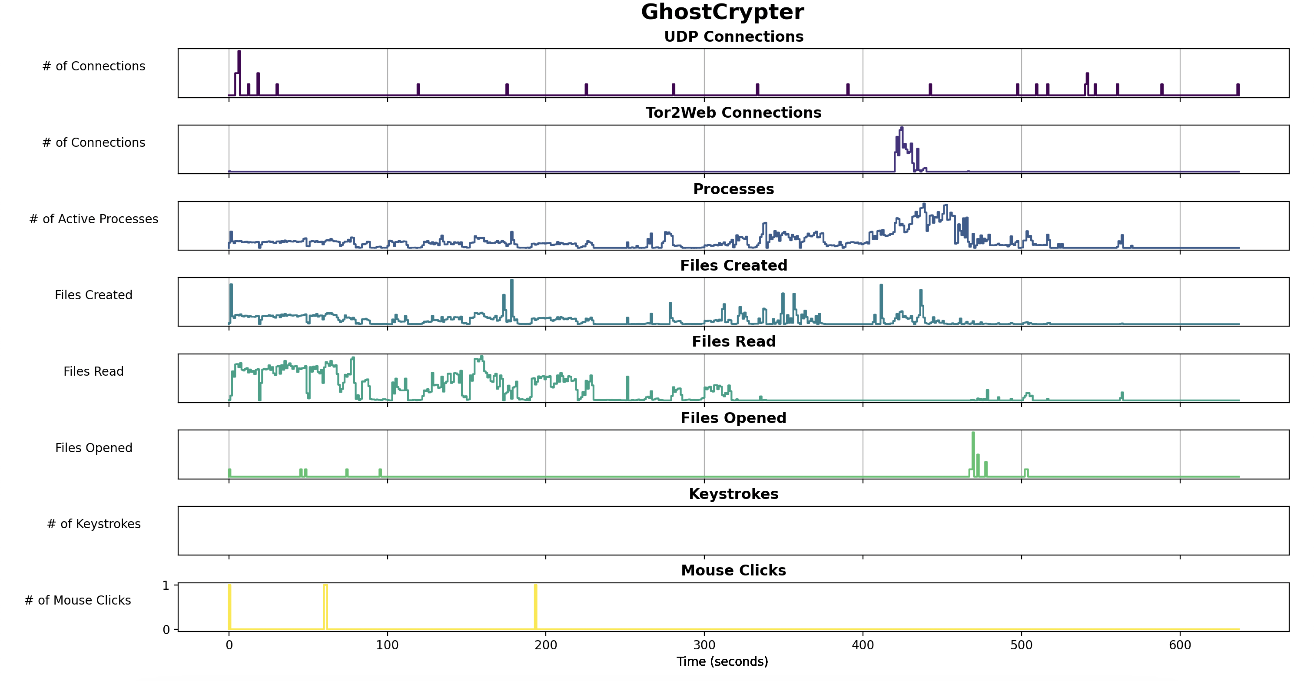
Results
Notes:
-our other result

Slide 6
Future Work
Current MQP?
Possible use of LLM to determine when user activity can lead to a ransomware attack (zero-day)

